Slide 1

TimeStamp
“Timekeeping Made Easy”
Jason Jamil, Steve Haikio, Alex Jabiro, Patric Abbo, Stefan Orban, Mario Saad, Adrian Pekala

Slide 2


THE VISION
The Vision for TimeStamp is to create a DCAA compliant online timecard system. The users will be able to create accounts as they are assigned different projects. The user will then sign in with their logins and be able to select the certain project they are working on at that moment. Once they hit the punch button, it will start a timer for how long that person has spent on said project. The user will then punch out once they are done working on the project. TimeStamp will then record and store all punches in a database that will be accessible to those with admin privileges only. The admin will have the ability to make any changes to timecards if need be. Each user account will also have an option for submitting expenses for each project. The system will also have the ability to generate invoices for each user account.

Slide 3

DCAA COMPLIANCE
“Defense Contract Audit Agency”
Authorized Charge Codes
Restrict Employees to only charge codes they need.
Timekeeping & Payroll Separated
The system will only track employee hours as DCAA does not allow both functions.
Timesheet Audit Trail
All timesheets will contain a detailed audit trail that captures any & every change made to a timesheet.

Slide 4
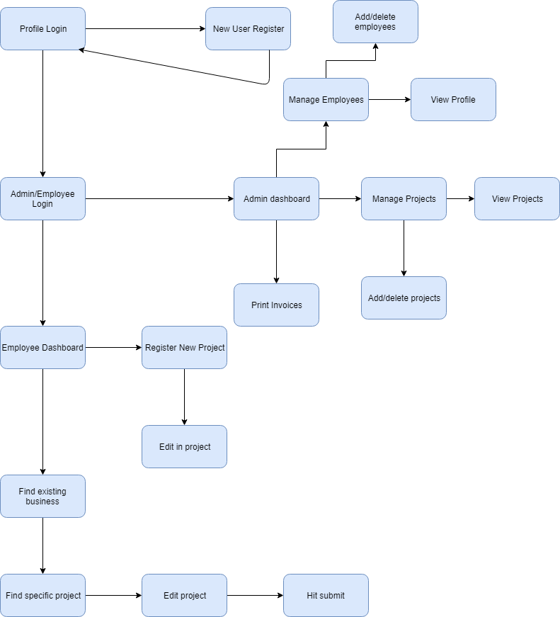
UX
FLOW
CHART

Slide 5

FEATURES & FUNCTIONS
The Features for TimeStamp are:
Allow new users to create accounts
Assigned projects will show up under each user account
Give users the ability to punch in/out of said project
All data will be stored in the database and will be accessible to accounts with admin rights only
Allow admins to change/edit any user account and assign new projects to specific users
Admins will then be able to see all user accounts and the time spent on each project
Mobile friendly
Allow users to be able to submit expense reports for each project
Generate invoices to be billed out for each user

Slide 6





TOOLS & TECH: Languages/Programs
HTML
CSS
PHP
GitHub
AWS
Cloud 9
Trello

Slide 7
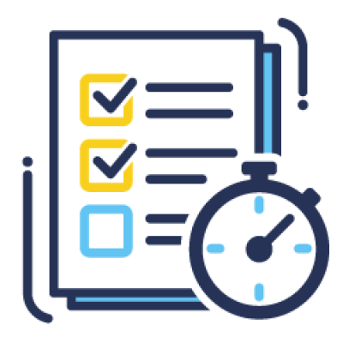
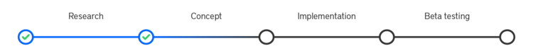
SPRINT PLANNING
Sprint 1: Come up with the idea of how to execute the project and align on all the tools to use. Create and have a working AWS server to host our database along with the site that users will use to punch in and out. (Complete by 9/12/19)
Sprint 2: Create the site using HTML. The site will consist of 2 seperate types of accounts: Admin and standard user. Standard users will also have the ability to create a “New User” Admins will have access to view all timecard data and make changes if need be. (Complete by 9/19/19)
Sprint 3: Connect the site to the database to allow user punches to be stored. Being able to write to the database will then allow admins to have access to all time data. (Complete by 10/3/19)

Slide 8
SPRINT PLANNING
Sprint 4: Assign privileges to each type of account with DCAA compliance.. Admins will have full privileges over the database and will be allowed to make changes as need be. (Complete by 10/15/19)
Sprint 5: Test standard user account. This will ensure that when making a standard user account, their punches are stored accordingly in the database and are accessible by the admins (Complete by 10/29/19)
Sprint 6: Allow admins to be able to make changes to the punches accordingly. This sprint will consist of making sure that each account type works and that admins will be able to view and edit the data. (Complete by 11/12/19)

Slide 9
SPRINT PLANNING
Sprint 7: This sprint will consists of making the site is user friendly and be focused on the way everything looks. This sprint will be the finishing touches to the overall look of the project. (Complete by 11/26/19)
Sprint 8: This stage of the project will be considered our Dry run. At this point everything should work and look like a finished product. (Complete by 12/3/19)
Final: Final Project Presentation (12/10/19)

Slide 10

THE CHALLENGES
Becoming familiar with DCAA Compliances
Getting familiar with GitHub
Setting up and hosting our own AWS server
Android Studio
Working with AWS
How to use frameworks
Learning different languages

